Slide 1

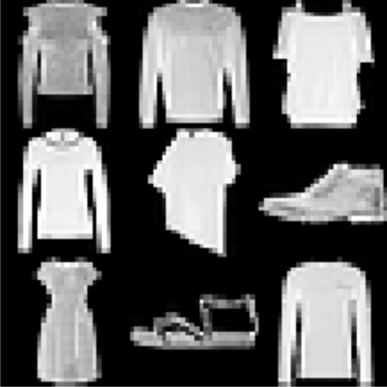
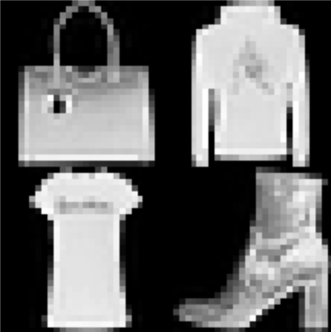
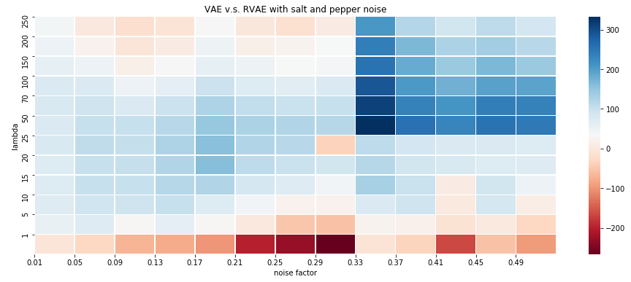
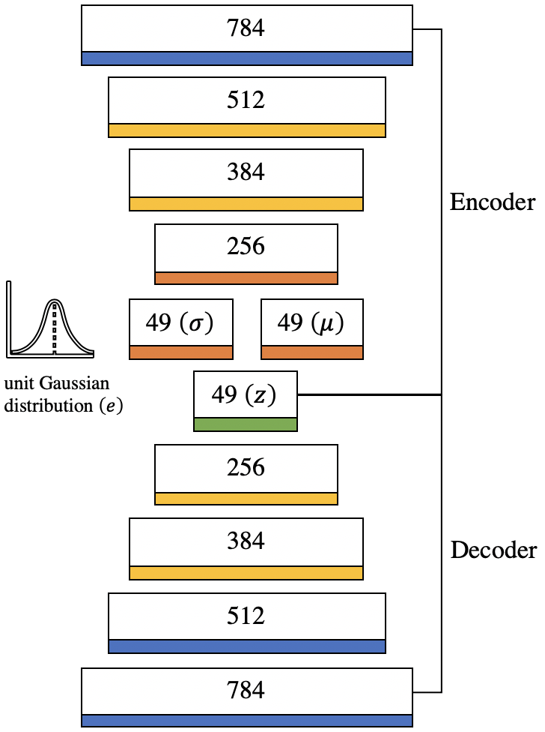
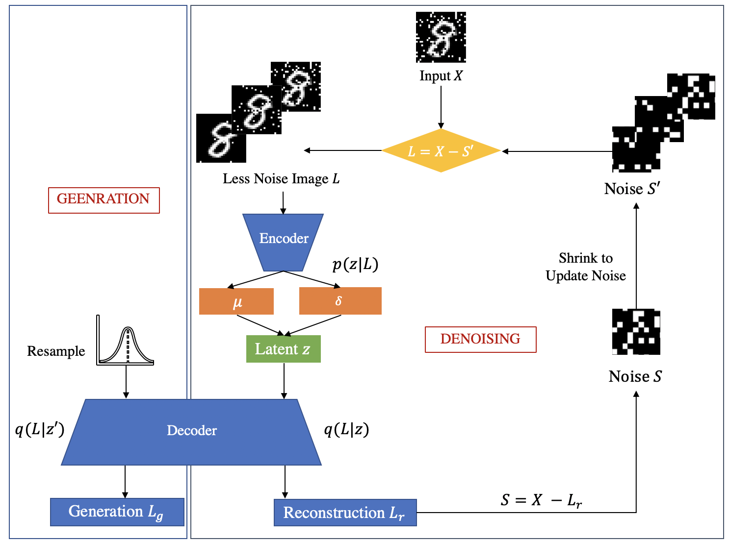
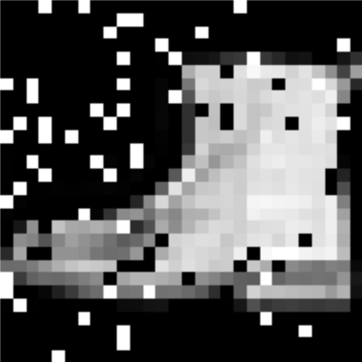
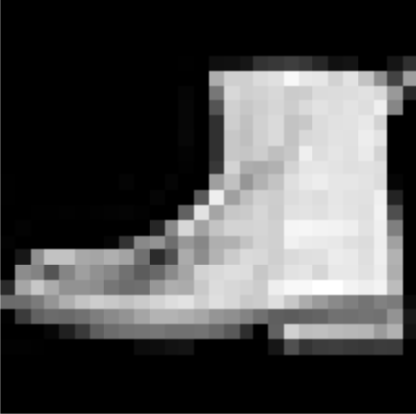
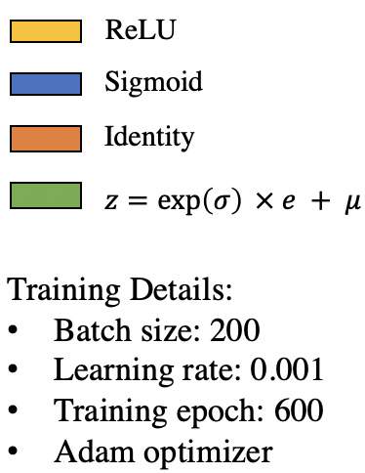
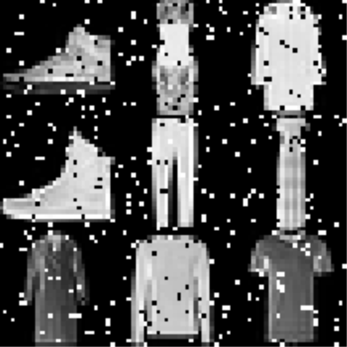
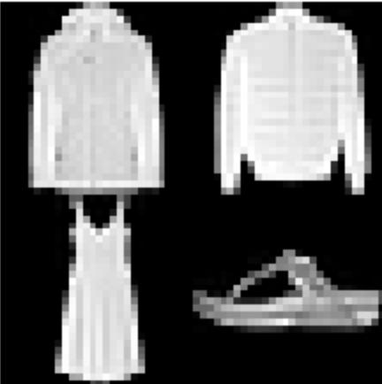
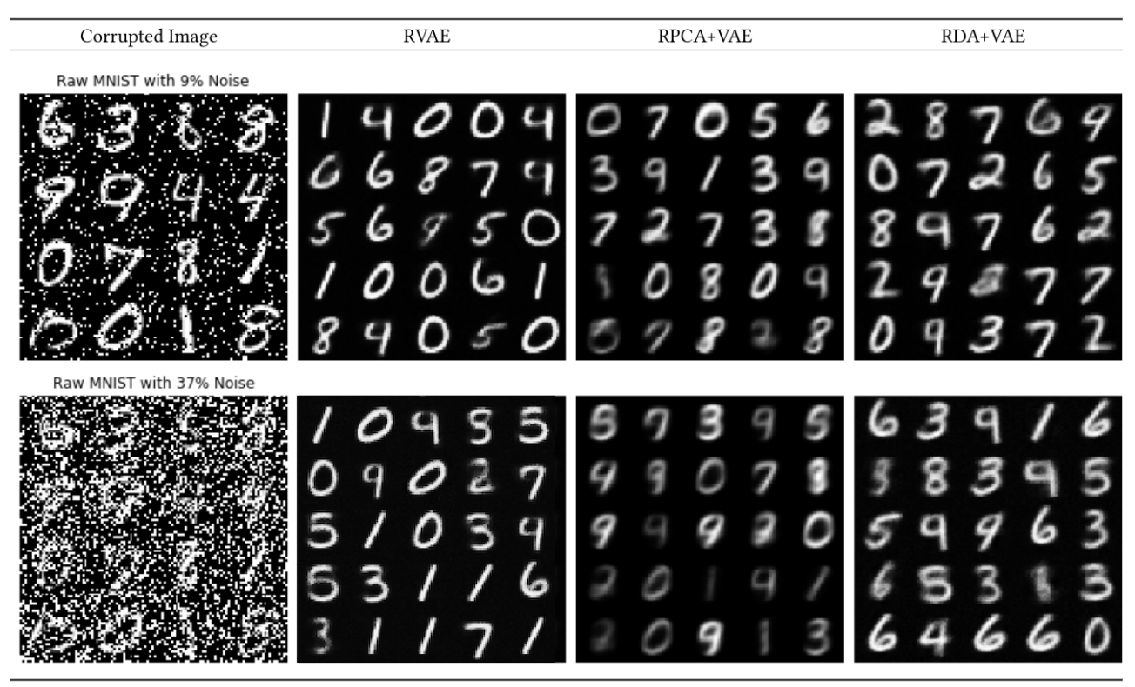
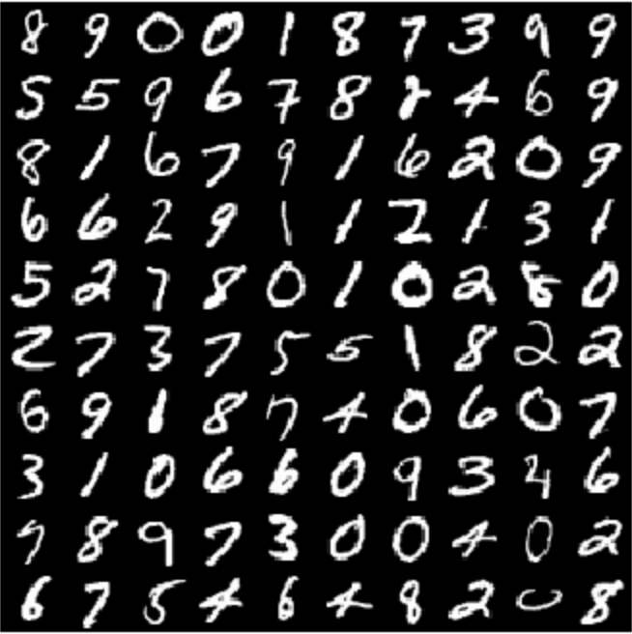
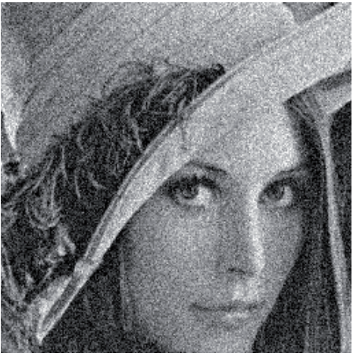
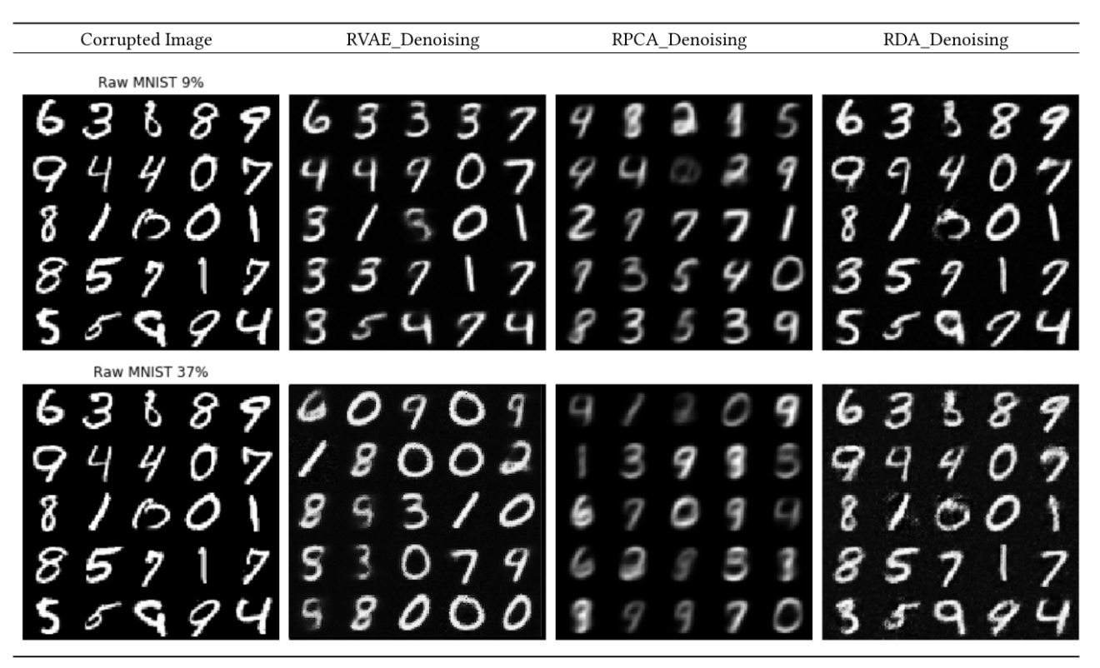
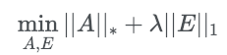
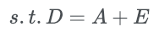
Robust Variational Autoencoder
Huimin Ren, Yun Yue, Chong Zhou
Advisors: Yanhua Li, Randy Paffenroth
Motivation
f
Methodology
Co
Results
Architecture of VAE
Structure of RVAE
VAE v.s. RVAE with salt-and-pepper Noise
Generative models are useful tools that have successfully applied to many application domains. Many studies have been proposed to recover the true images from corrupted images. But none of them consider about how to generate high quality images when no clean, noise-free images are available.
Generative Models
Denosing Models
Lambda
?
Noise Factor
Examples of Generated Images
Problem Define:
How to generate new clean images when no noise-free data is available?
f
Introduction
Robust Variational Autoencoders (RVAE) has been proposed as a novel denoising generative model to bridge the research gap of creating realistic images directly from noisy input data. RVAE is extended from Robust Principal Component Analysis (RPCA), Robust Deep Autoencoders (RDA) and Variational Autoencoders (VAE).
Experiment Results
Co
Implementation Details
Data set:
MNIST
Salt-and-pepper Noise
Gaussian Noise
Examples of Denoised Images
Robust Principal Component Analysis (RPCA)
Benchmark models:
- VAE, a generative model which uses the same structure as RVAE.
- RPCA+VAE, a two-stage model, which uses RPCA to denoise and then uses VAE to generate new images.
- RDA+VAE, a two-stage model, which uses RDA to denoise and then uses VAE to generate new images.
Conclusion
Variational Autoencoders (VAE) ^{[2]}
Co
Minimize reconstruction error
Minimize Kullback-Leibler (KL) divergence
Bridged the research gap between denoising and generation if only corrupted and unannotated data accessible.
Demonstrated the robustness of our proposed method using different method of corruption.
Beat the two-stage model such as denoising with RPCA and generating with VAEs.
Evaluation Metrics
To judge the quality of images we generate the “Fréchet Inception Distance” (FID) ^{[6]} score, which is computed by considering the similarity of two distributions, the fake images and true ones. FID ranges from 0 to infinity that a small score of FID indicates a high similarity between the fake and true images. The following shows the formula of FID:
Co
Acknowledge
This research project is supported in part by NSF grants CNS-1657350 and CMMI-1831140.

